Slide 1
Lecture 8 (Chapter 11)
Abstract Data Types and Encapsulation Concepts

Slide 2
Chapter 11 Topics
The Concept of Abstraction
Introduction to Data Abstraction
Design Issues for Abstract Data Types
Language Examples
Parameterized Abstract Data Types
Encapsulation Constructs
Naming Encapsulations

Slide 3
The Concept of Abstraction
An abstraction is a view or representation of an entity that includes only the most significant attributes
The concept of abstraction is fundamental in programming (and computer science)
Nearly all programming languages support process abstraction with subprograms
Nearly all programming languages designed since 1980 support data abstraction
Ada is the early advocator of

Slide 4
Introduction to Data Abstraction
An abstract data type is a user-defined data type that satisfies the following two conditions:
The representation of objects of the type is hidden from the program units that use these objects, so the only operations on objects are those provided in the type's definition
The declarations of the type and the protocols of the operations on objects of the type are contained in a single syntactic unit.
Single syntactic unit: e.g. class, unit, module, …
Other program units are allowed to create variables or objects of the defined type.

Slide 5
Advantages of Data Abstraction
Advantages the first condition
Reliability--by hiding the data representations, user code cannot directly access objects of the type or depend on the representation, allowing the representation to be changed without affecting user code
Reduces the range of code and variables of which the programmer must be aware
Name conflicts are less likely
Advantages of the second condition
Provides a method of program organization
Aids modifiability (everything associated with a data structure is together)
Separate compilation

Slide 6
Language Requirements for ADTs
A syntactic unit in which to encapsulate the type definition
A method of making type names and subprogram headers visible to clients, while hiding actual definitions
Some primitive operations must be built into the language processor
Design Issues
Can abstract types be parameterized?
What access controls are provided?
Is the specification of the type physically separate from its implementation?

Slide 7
Language Examples: C++
The class is the encapsulation device
A class is a type
All of the instances of a class share a single copy of the member functions
Each instance of a class has its own copy of the class data members
Instances can be static, stack dynamic, or heap dynamic
Information Hiding
private clause for hidden entities
public clause for interface entities
protected clause for inheritance (Lecture 12)
friend functions or classes - to provide access to private members to some unrelated units or functions

Slide 8
Language Examples: C++ (continued)
Constructors:
Functions to initialize the data members of instances
they do not create the objects
May also allocate storage if part of the object is heap-dynamic
Name is the same as the class name
Can include parameters to provide parameterization of the objects
Implicitly called when an instance is created
Can be explicitly called
Destructors
Functions to cleanup after an instance is destroyed
usually just to reclaim heap storage
Name is the class name, preceded by a tilde (~)
Implicitly called when the object’s lifetime ends
Can be explicitly called

Slide 9
An Example in C++
class Stack {
private:
int *stackPtr, maxLen, topPtr;
public:
Stack() { // a constructor
stackPtr = new int [100];
maxLen = 99;
topPtr = -1;
};
~Stack () {delete [] stackPtr;}; //destructor
void push (int number) { //member function
if (topSub == maxLen)
cerr << ″Error in push - stack is full\n″;
else stackPtr[++topSub] = number;
};
void pop () {…}; //more member functions
int top () {…};
int empty () {…};
} //end of class Stack
The class definition could also be written into a header file and a code file as shown in next two slides.

Slide 10
A Stack class header file
// Stack.h - the header file for the Stack class
#include <iostream.h>
class Stack {
private: //private members are visible only to other members and friends
int *stackPtr;
int maxLen;
int topPtr;
public: //public members are visible to clients
Stack(); //constructor
~Stack(); //destructor
void push(int);
void pop();
int top();
int empty();
}
Stack s; //a stack-dynamic object
Stack *ps = new Stack();
//a heap-dynamic object

Slide 11
The code file for Stack
// Stack.cpp - the implementation file for the Stack class
#include <iostream.h>
#include "Stack.h"
using std::cout;
Stack::Stack() { //implementation of constructor
stackPtr = new int [100]; //allocation of heap-dynamic storage
maxLen = 99;
topPtr = -1;
}
Stack::~Stack() { //implementation of destructor
delete [] stackPtr; //deallocation of heap-dynamic stroage
};
void Stack::push(int number) {
if (topPtr == maxLen)
cerr << "Error in push--stack is full\n";
else stackPtr[++topPtr] = number;
}
...

Slide 12
Language Examples: Java
Similar to C++, except:
All user-defined types are classes
All objects are allocated from the heap and accessed through reference variables
Individual entities in classes have access control modifiers (private or public), rather than clauses
public void push (…) { … }
public void pop() { …}
- Implicit garbage collection of all objects
Java has a second scoping mechanism, package scope, which can be used in place of friends
All entities in all classes in a package that do not have access control modifiers are visible throughout the package

Slide 13
An Example in Java
class StackClass {
private int [] stackRef;
private int [] maxLen, topIndex;
public StackClass() { // a constructor
stackRef = new int [100];
maxLen = 99;
topPtr = -1;
};
public void push (int num) {…};
public void pop () {…};
public int top () {…};
public boolean empty () {…};
}
StackClass myS
= new StackClass();
//myS is an object reference.
//The StackClass object is
//explicitly (via new) //allocated on heap

Slide 14
Parameterized Abstract Data Types
Parameterized ADTs allow designing an ADT that can store any type elements
only an issue for static typed languages
Also known as generic classes
C++, Java (since Java 5.0), C# etc. provide support for parameterized ADTs

Slide 15
Generic classes in C++
Classes can be somewhat generic by writing parameterized constructor functions
Stack (int size) {
stk_ptr = new int [size];
max_len = size - 1;
top = -1;
};
A declaration of stack objects:
Stack smallStk (10), largeStk (150);
// The above Stack definition provided limited “generic” feature
// i.e. “generic” in terms of stack size
Demand for more powerful “generic” definitions
What about a stack of integer, a stack of double, a stack of student objects?
Do we have to define each of them separately, or could have a generic definition of stack?

Slide 16
C++: template classes
The stack element type can be parameterized by making the class a template class template <class Type> class Stack { private: Type *stackPtr; const int maxLen; int topPtr; public:
Stack(int size) { // Constructor for a given number
stackPtr = new Type[size];
maxLen = size – 1;
topSub = -1;
}
void push (Type e) { … } ... }
- Instantiation:
Stack<int> myIntStack;
Stack<double> myDblStack;

Slide 17
Parameterized Classes in Java 5.0
Generic parameters must be classes
Most common generic types are the collection types, such as LinkedList and ArrayList
Users can define generic classes
Generic collection classes cannot store primitives
Indexing is not supported
Example of the use of a predefined generic class:
ArrayList <Integer> myArray = new ArrayList <Integer> ();
myArray.add(0, 47); // Put an element with subscript 0 in it

Slide 18
Java: user-defined Parameterized Classes
import java.util.*;
public class Stack2<T> {
private ArrayList<T> stackRef;
private int maxLen;
public Stack2() {
stackRef = new ArrayList<T> ();
maxLen = 99;
}
public void push(T newValue) {
if (stackRef.size() == maxLen)
System.out.println(" Error in push – stack is full");
else
stackRef.add(newValue);
...
}
}
- Instantiation: Stack2<string> myStack = new Stack2<string> ();

Slide 19
Encapsulation
In OOP, encapsulation refers to the bundling of data with the methods that operate on that data, or the restricting of direct access to some of an object's components.
ADTs can be used as encapsulation constructs
However, some languages provide additional encapsulation constructs to support
Better program organization
Partial/separate compilation
…

Slide 20
Abstraction vs. Encapsulation
Abstraction — Implementation hiding.
Hide unwanted details
Encapsulation — Information hiding.
Hide the data to protect from outside
private, public, protected
ADT: both abstraction and encapsulation

Slide 21
Encapsulation Constructs
Large programs have two special needs:
Some means of organization, other than simply division into subprograms
nested subprograms is one of the organization means
Some means of partial compilation (compilation units that are smaller than the whole program)
Obvious solution: a grouping of subprograms that are logically related into a unit that can be separately compiled (compilation units)
Such collections are called encapsulation
e.g. C# assembly

Slide 22
Encapsulation in C
Files containing one or more subprograms can be independently compiled
The interface is placed in a header file
Problems
the linker does not check types between a header and associated implementation
the inherent problems with pointers
#include preprocessor specification – used to include header files in applications

Slide 23
Example in C
//factorial.h – the header file
int factorial (int n) {
int result=1, iter;
for (iter=1; iter<=n; iter++)
result *= iter;
return result;
}
//myProg.c - client program that uses factorial
#include “factorial.h”
int main () {
int f5 = factorial (5);
…
}
A header file may include declarations only, as commonly used.

Slide 24
Encapsulation in C++
Can define header and code files, similar to those of C
Or, classes can be used for encapsulation
The class is used as the interface (prototypes)
The member definitions are defined in a separate file
Example: stack.h and stack.cpp (next slide)
Reference: CPP Forum

Slide 25
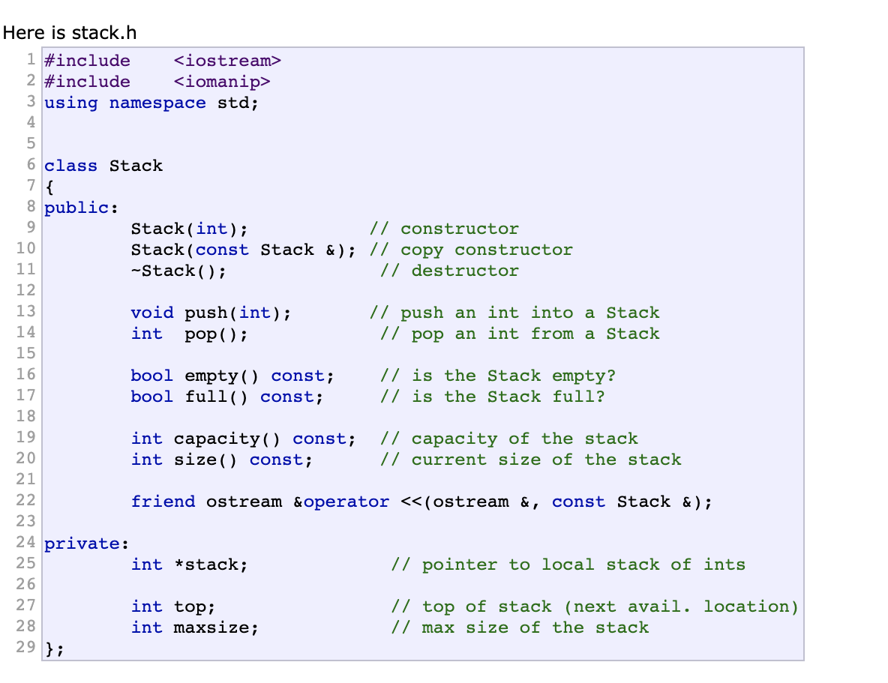

Slide 26
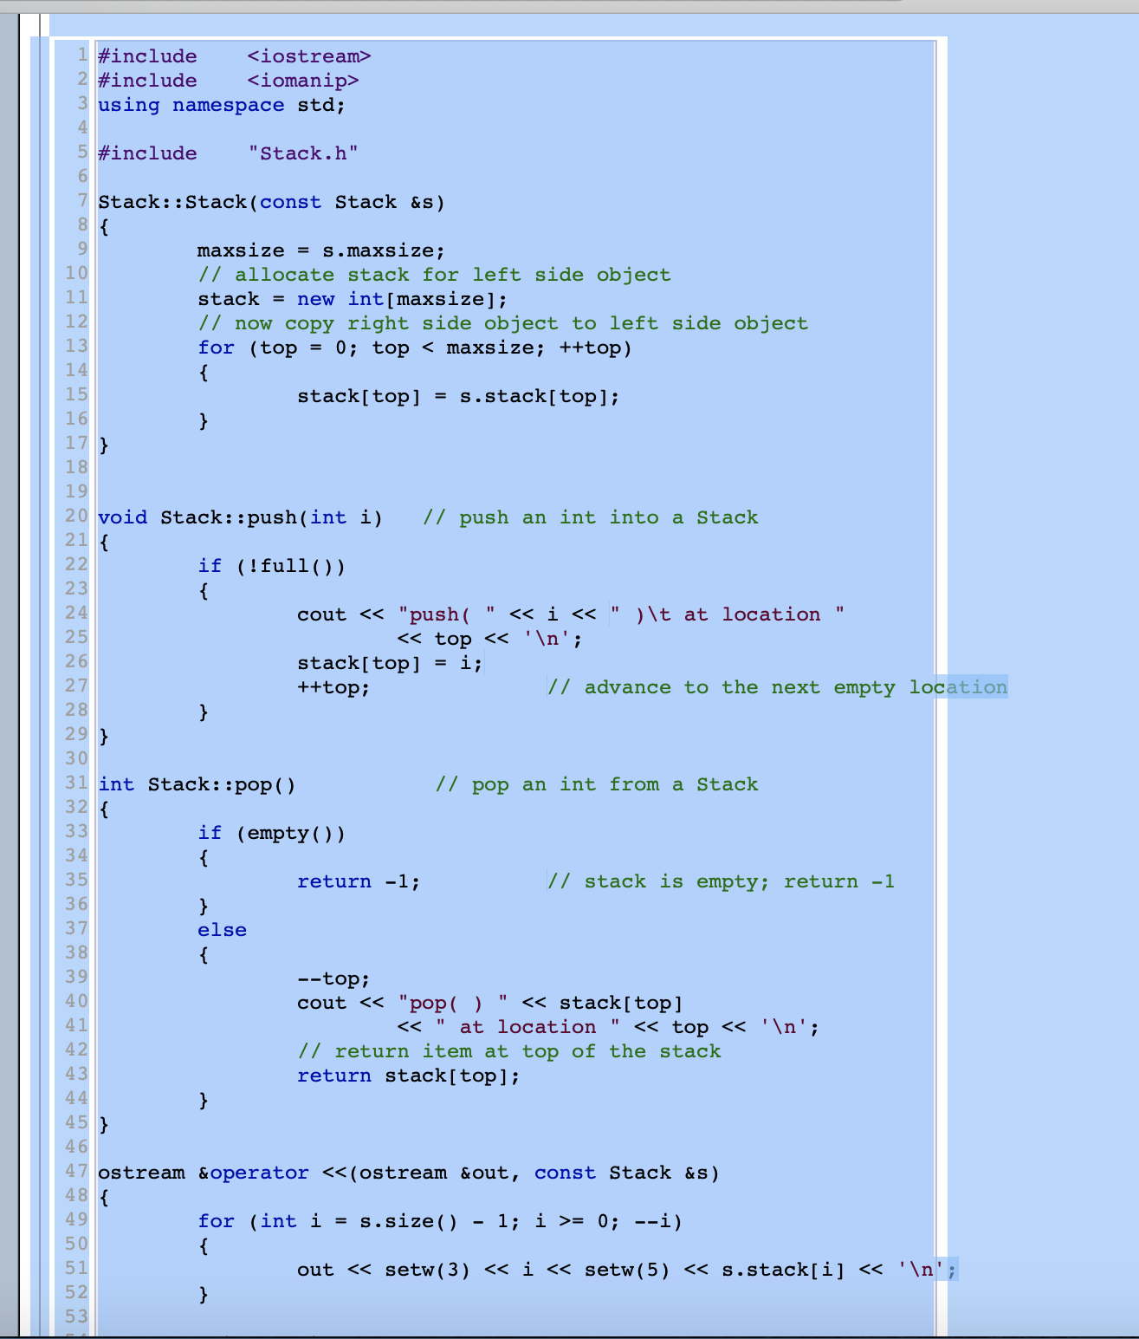
Stack.cpp

Slide 27
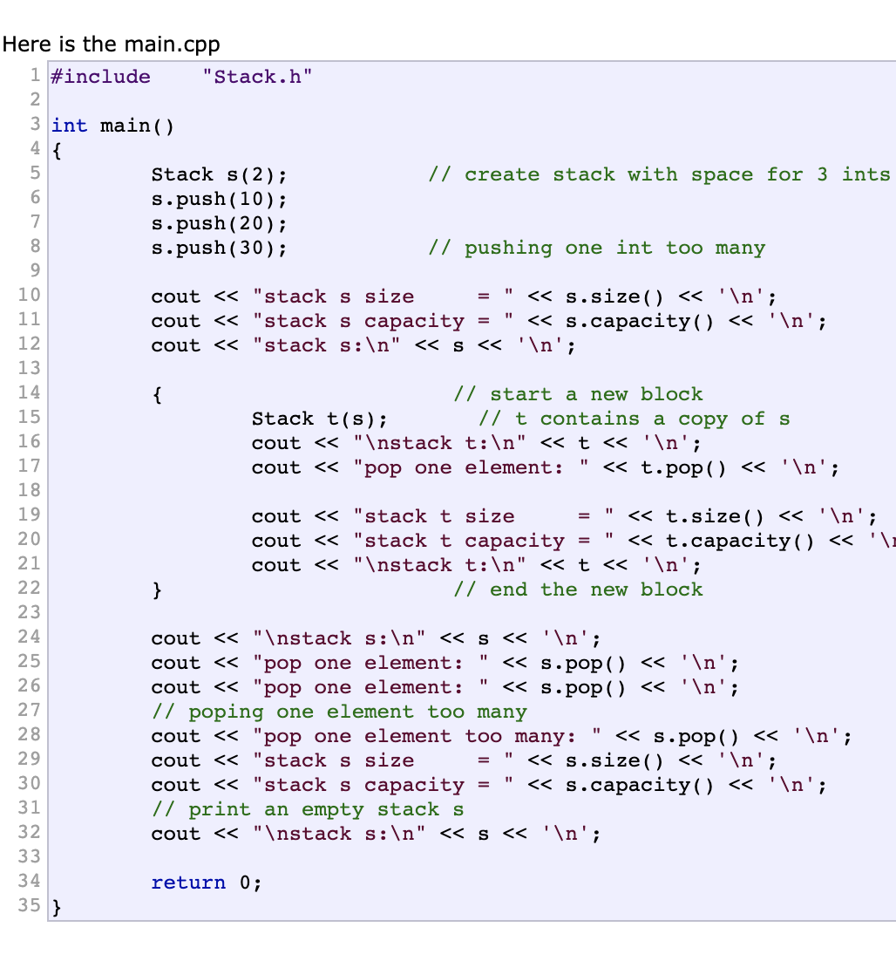

Slide 28
Naming Encapsulations
Large programs define many global names; need a way to divide into logical groupings
A naming encapsulation is used to create a new scope for names
C++ and C# Namespaces
Can place each library in its own namespace and qualify names used outside with the namespace
Java Packages
Packages can contain more than one class definition; classes in a package are partial friends
Clients of a package can use fully qualified name or use the import declaration
Ruby modules and so on …

Slide 29
Example: C++ Namespace
#include <iostream>
using namespace std;
namespace first {
int x = 5;
int y = 10;
}
namespace second {
double x = 3.1416;
double y = 2.7183;
}
int main () {
using first::x;
using second::y;
cout << x << endl;
cout << y << endl;
cout << first::y << endl;
cout << second::x << endl;
return 0;
}

Slide 30
Summary
The concept of ADTs and their use in program design was a milestone in the development of languages
ADTs also serve as an essential component of OOP
Two primary features of ADTs are the packaging of data with their associated operations and information hiding
Many different ways of supporting ADTs
C++ data abstraction is provided by classes
Java’s data abstraction is similar to C++
C++, Java, and C# support parameterized ADTs
Encapsulations support larger problem development
C++, C#, Java, and Ruby provide naming encapsulations

